Slide 1
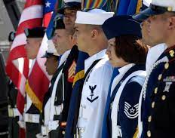
Moving Veterans Forward Career Toolkit

Slide 2
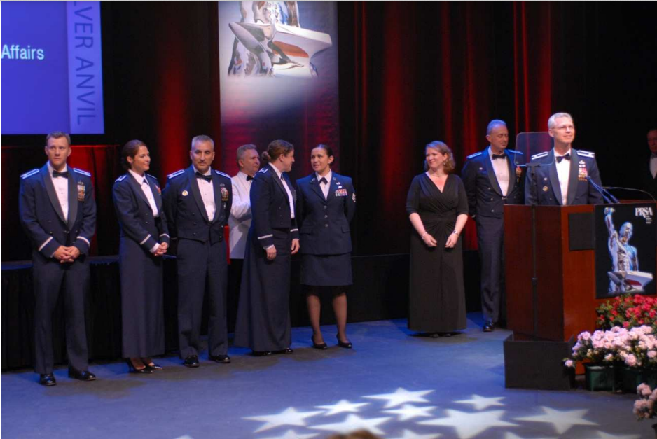
Transitioning from the Military into your next career
The Moving Veterans Forward Program is a complimentary service from PRSA to assist transitioning military service members
This program offers 20 free PRSA memberships each year for one year, allowing you to continue to learn your craft as you transition
Through it, we can help you tailor your next steps for a successful career change

Slide 3
Military Accomplishments Fitting Into Civilian Jobs
Your military experience has made you an expert communicator.
Your troops have depended on you; you have dispatched orders, handled crises, and saved countless lives.
But how do you translate these skills to get hired?
There’s much hope, and PRSA is here to help.

Slide 4
Your Career Battleplan
Networking
Job interview
Overall tips
LinkedIn
Additional resources
Final remarks
Personal branding
The Job Interview
Cover letters
Resumes
Phrases to assist
Converting Military to Civilian Terms
Facing Recruiter Feedback with Grace
Fields to Consider
You served your country and you’re ready to transition into civilian life. PRSA is here to help. The first step is finding the right job that emphasizes your skills as a leader, motivator and team player. This document provides the following career content to place you on that path. Topics being covered are:

Slide 5
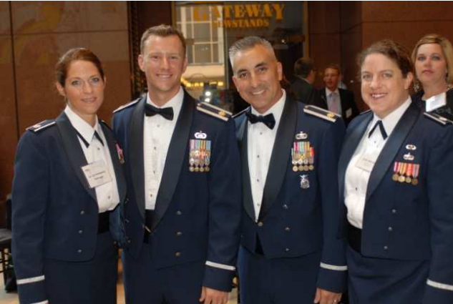
Networking Opportunities
PRSA Chapter events
PRSA Professional Interest Sections
MyPRSA Online Community
Survey your network
Build your network on LinkedIn, Facebook or Google+.
Get out there and Network!

Slide 6
PRSA Jobcenter Career Resources
Job hunting advice
Resume and cover letter help
Networking guides
Interview advice
Mentoring
Salary Information
Career guidance from your peers
Notes:
Search jobs by location and keywords on
https://jobs.prsa.org
Follow @prsajobcenter on twitter to see real time job opportunities
Create a job alert
Sign up for the PRSA Jobseeker Career E-newsletter

Slide 7
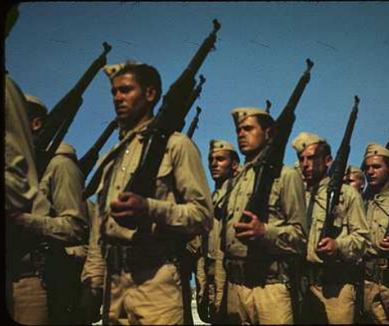
Overall tips
Build relationships.
Give to get (reciprocity).
Find mutual personal interests.
Write a blog.
Be honest and authentic.
Engage on social media.
Join the Military and Veterans Task Force Community in PRSA

Slide 8
LinkedIn
Profile is the most important element.
Use the “specialties” section to place keywords.
Must have a picture.
Say what you do (e.g., multi-cultural program).
Keep profile relevant and up-to-date.
Make sure your resume and profile match.
Complete your profile.
Join up to 50 different specialty groups.
Information courtesy Sandy Charet – Charet Associates.

Slide 9
Personal Online Branding Guidelines
Can you be found online easily? If you were to Google yourself, where would you place and can you be found?
Build, enhance and/or check your profiles on LinkedIn, Facebook, Twitter etc.
Start building an online portfolio of your work.
Establish a blog or other social media platform to provide thought leadership about your field.
Do this wisely. Everything you post online —pics, comments is now public domain.

Slide 10
Personal Branding: Your Brand Identity
1. Establish an online identity.
- Own your domain name.
- Differentiate yourself.
- Develop consistent LinkedIn,
- Twitter, Facebook and other profiles
- Work with brandyourself.com
2. Personalize URLs
- Strengthens your search engine optimization (SEO) related to your brand.
- Check through http://namechk.com/ if name is still available.
3. Develop content
- Use Google Alerts to receive daily updates on selected topics.
- Share content through a personal blog site such as WordPress.

Slide 11
Your Brand Identity
4. Promote brand name.
5. Promote content.
6. Actively network via associations and LinkedIn.
7. Engage your audience.
- Review and respond to postings in a timely manner.
- Post questions to the group.
8. Monitor your brand.
- Establish a Google Alert for your brand.
- Use tracking sites like Social Mention.
9. Measure your online engagement.
- Based on actions such as retweets,
- @messages, follows, comments and likes.
10. Manage your brand presence.
Information courtesy Dr. Dawn Edmiston.

Slide 12
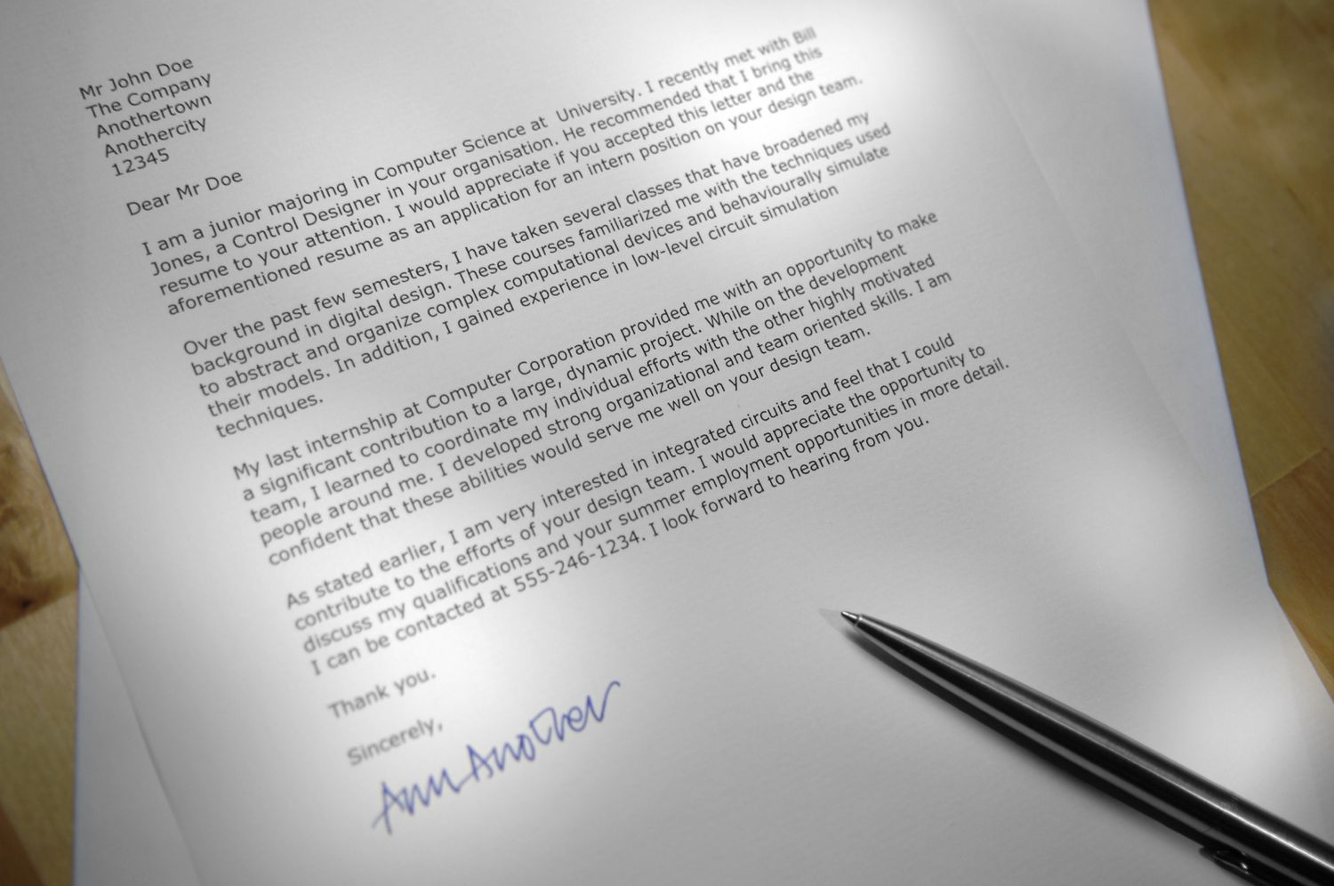
Cover Letters
Showcase key qualifications and what sets you apart from other candidates.
No more than two paragraphs.
Inspiring and brief.
Grab their attention. Do not repeat your resume. Study the job description and company.
What can you add to the position that no one else can?
Put just enough in the cover letter to entice, but not too much.

Slide 13
Resumes
Six seconds to attract a recruiter’s attention
Keep it organized
Review it
- Upload your resume to PRSA Jobcenter and opt-in for a free resume review
Start with a background summary
Use language in the job description
Express your accomplishments, achievements and service

Slide 14
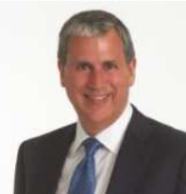
Resume Background Summary Suggestions from recruitment experts
“Emphasize strong hands-on skills, strategic thinking and leadership ability.”
“Include most prominent public relations skills, niche specialty/categories, industry specialization.”
George Jamison Spencer Stuart
Dennis Spring of Spring Associates

Slide 15
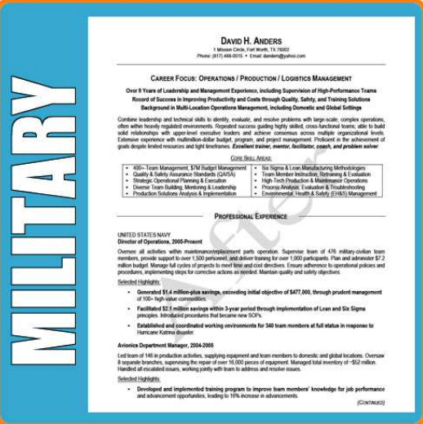
Resume Guidelines
Focus on what you’ve accomplished for past employers.
Tightly target to your audience. Use relevant words.
Use action words that paint a picture of who you are and your value.
Use storytelling techniques.
Make the resume fit each opportunity. Tailor the resume to each job description.
Match keywords to the job description.
Create one very long “master” resume and pull what you need for each application based on job description.
Attend on-base resume writing courses when available.
No two resumes should look the same.
Google “resume that went viral.”
Log on to PRSA Jobcenter as employer and select “view resumes.”
Information courtesy PRSA Mentors and College of Fellows

Slide 16
Potential Phrases to Incorporate in Your Resume (Communications)
Led multi-service communications team.
Developed external/internal communications program.
Employed communication strategies/programs.
Identified communication gaps and initiated updates.
Managed marketing and communications strategy.
Managed marketing and communications execution.
Spokesperson at unit/regional levels.

Slide 17
Phrases to Consider (Media Relations)
Responded to international, national and local media.
Directed outreach campaign.
Targeted themes.
Coordinated integrated public outreach programs.
Responded to media queries.
Created talking points.
Spearheaded service line marketing/development campaigns.
Targeted national outreach.
Provided interview techniques.

Slide 18
Phrases to Consider (Strategic)
Results-oriented communicator.
Developed outreach strategies.
Developed strategy/executed plans for senior leader implementation.
Defined and executive integrated marketing strategies.
Developed marketing and business strategies.

Slide 19
Phrases to Consider (Leadership)
Provided sound advice and counsel.
Wrote implementation plan for field headquarters.
Orchestrated branding campaign.
Prepared health care and Air Force senior leaders to succeed in media engagements.
Led seminars.
Led public-relations-focused trips.
Guided the Air Force through career field mergers following workforce cuts.

Slide 20
Phrases to Consider (Social Media & Tactical)
Directed Facebook page.
Developed social media plan.
Initiated company blog.
Created Pinterest page for company.
Created and maintained Twitter page.
Led content curation for blogs and tweets.
Produced e-newsletter.
Tracked results.
Possess strong organization skills.
Able to translate technical information into easy-to understand text.

Slide 21
Converting Military to Civilian Terms: Example
Military platoon leader, leading petty officer, section leader = front line supervisor in the corporate world.
Supervised and evaluated up to 75 employees.
Conducted high-quality training for groups up to twenty-five employees.
Improved staff productivity and efficiency by 30 percent.
Enforced 100 percent of company policies and procedures.
Submitted comprehensive and timely reports to supervisor.
Source: TAPS Guide

Slide 22
Converting Military to Civilian Terms: Creating Accomplishment Statements
Think of this as a story with a title. Identify the scenario. Some topics (titles) may include:
A task you performed alone.
A project you worked on as a team member/team leader.
A challenge you overcame in the job setting.
A problem you solved.
A goal you set.
Source: TAPS Guide

Slide 23
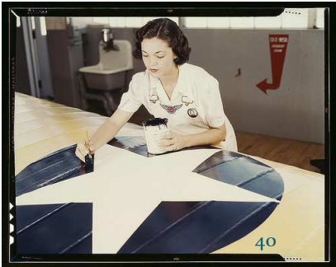
Converting Military to Civilian Terms: Measurable Results (Examples)
… which reduced accidents from 30 percent to fewer than 2 percent in two weeks.
… which enabled constant communication in four different states.
… which increased the training rate of employees by 45 percent.
… that provided search and recovery support for disaster victims.
Source: TAPS Guide

Slide 24
Your Military Experience and the Job Interview —Introduction
How did your military career prepare you for this job?
Remember, your military experience has made you an expert at leading, inspiring and following instructions — attributes applicable to any position. Below are some qualities to emphasize in the interview.
Mission-focused
Discipline
Commitment
Team leader
Flexibility
Writing skills
Problem-solving skills
Organized
Good planner
Priority-driven
Honesty
Integrity

Slide 25
The Job Interview — Guidelines
Research (website, media articles, analyst reports, social media channels, press releases, friend, etc.)
Keep calm during the unexpected questions.
Practice your one-on-one interview.
Work on your public speaking.
Ask questions to show significant interest.
Be authentic…Be You!

Slide 26
Interview Mistakes That Can Take You Out of the Running…
Any negativity about a previous job experience.
Showing up late.
Not dressing for success.
Being unprepared in researching the company.
Not following up with a thank-you email.
Having a vague understanding of the job description.
Not following instructions on the application.

Slide 27
Facing Recruiter Feedback With Grace
Be Kind: Reinforce you are willing to take any classes or tutorials to get hired.
Be Brief: Do not tell them you are surprised you didn’t get the position. Limit questions to one or two ones.
Be Prepared: Don’t be defensive when taking criticism.
Be a Good Listener: Listen to what is said and how it is said.

Slide 28
Fields to Consider
Advocacy
Corporate/employee communications
Community relations
Educational institutions
Media liaison/media relations
Media training
Nonprofit/associations
Organizational management
Public affairs/government
Public relations
Journalism
Investor relations
Technology
Health
Travel/tourism

Slide 29
Additional Info: Overall Tips
Look for companies that advertise their support of Veterans —aerospace and defense companies, Coca-Cola, etc.
Be prepared to take a brief step back in your career to get your foot in the door.
Look for associations that have employer toolkits to hire military.
Consider going for your Accreditation in Public Relations + Military Communications (APR+M). Consult PRSA.
Think like a public relations or communications professional.
Explain your value in civilian terms.

Slide 30
Resources for Information
Public Relations Society of America (PRSA): www.prsa.org
Transition Assistance Program (TAP)
LinkedIn Group —America’s Heroes at Work
Converting military to civilian terms: http://www.careerinfonet.org/moc/Default.aspx
Military Officer’s Association of America (MOAA): www.moaa.org

Slide 31
Final Remarks
Check PRSA Jobcenter: https://jobs.prsa.org
Consult PRSA membership for special rates.
Tap into PRSA’s complimentary member webinars.
Consider signing up with a PRSA Mentor.
Consult award-winning Silver Anvil campaigns.
Contact john.Kesaris@prsa.org for career information.

