Slide 2
*Background on presenters*
List your PRSSA position, internships, education, graduations date, etc.
Each presenter can have their own slide

Slide 3
What is Public Relations?

Slide 4
video
PRSA National. “Why PR? What Motivates You.” Online Video Clip. YouTube, February 29, 2019. Web.

Slide 5
Public relations, as define by PRSA, “is a strategic communications process that builds mutually beneficial relationships between organizations and their publics.”

Slide 6
What do PR pros do?

Slide 7
They tell the story of your brand/company
They shape the debate/manage crisis situations
They research how consumers think
They write, and write some more
They plan events
They talk to the media

Slide 8
Could this be you? Do you like:
Writing
Networking
Telling Stories
Offering advice
Solving problems
Using social media
Organizing events
Learning
Public Speaking
Building relationships
Creating
Researching

Slide 9
Who Needs PR?

Slide 10
*Insert images of local/regional brands, companies, politicians, etc.*

Slide 11
Companies/brands
Celebrities
Sports teams/athletes
Politicians
Basically everyone
PR is in every industry!

Slide 12
What Does it Mean to Study PR in College?

Slide 13
Learn the techniques and skills needed for this career
Writing
Social media
Strategic Thinking
Research

Slide 14
Join PRSSA
Launch Your Career

Slide 15
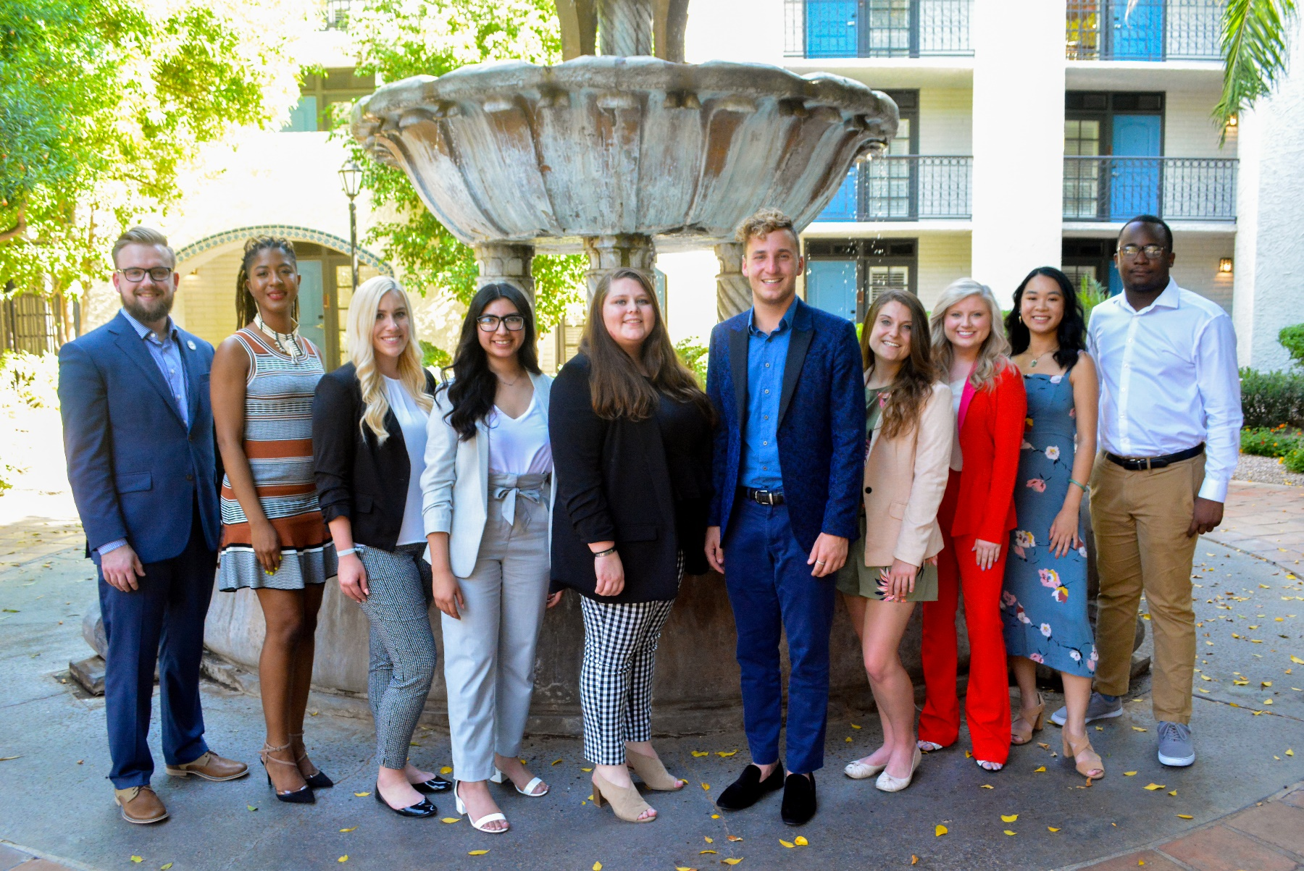
About Us
The Public Relations Student Society of America (PRSSA) is a pre-professional organization for college students interested in public relations and communications.

Slide 16
Enhance your education
Scholarships
Leadership opportunities
Broaden your network
Connect with professionals
Mentorship opportunities
Launch your career
Internships
Valuable and practical experience

Slide 17
Top Tips for Success

Slide 18
Time Management
Prioritization is key!
Eliminate unnecessary distractions
Involvement and Connections
Networking
Be active
Experience
Open Mindedness
Knowledge
Growth

Slide 19
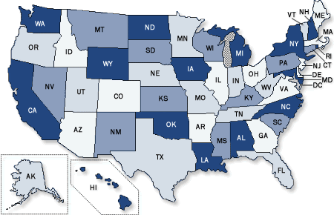
PRSSA has over 300 Chapter!

Slide 20
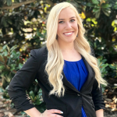
Connect with our National Committee
Nick Goebel
National President
nationalpresident@prsa.org @nick_goebel
Ashleigh Kathryn
Immediate Past President
immediatepastpresident@prsa.org @Ashleigh_K_W
McQue Wilson
Vice President of Member Services
vpmemberservices@prsa.org
@mcquewilson
@PRSSANational
PRSSA National
@PRSSANational

Slide 21
Questions?
Thank you!
*Leave contact information, like presenters’ emails or your Chapter’s email, in case students have questions later.*

